Slide 1
The Rise of Mass Democracy
The American Pageant,
Chapter 13

Slide 2
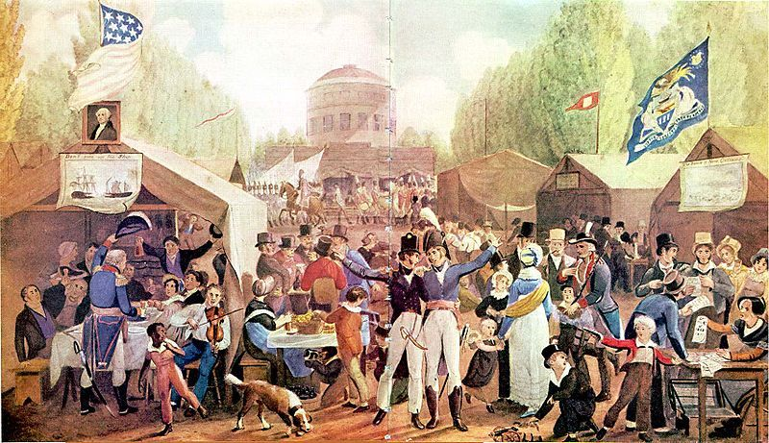
Era of Good Feelings Ends
Surge in nationalism following War of 1812, but…
Sectionalism
Missouri Compromise
Panic of 1819
Formation of new parties
1828—new parties emerge
Democrats
Whigs
“Get out the vote” campaigns
ie—suck up to the public
It works! Voter turnout increases up to 78% by 1840

Slide 3
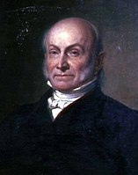
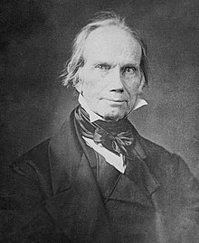
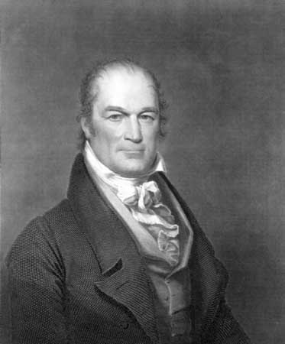
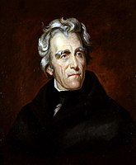
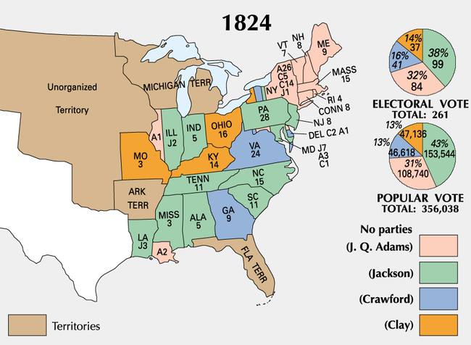
The Corrupt Bargain, 1824
Multiple candidates for president
John Q. Adams, Henry Clay, William Crawford, Andrew Jackson
Problem → Jackson gets most votes; does not get majority of the electorate
Gets more popular vote than the next two combined
12th Amendment—the House of Representatives decides
Clay is out by votes—he’s also Speaker of the House
Crawford has a stroke
Clay hates Jackson

Slide 4
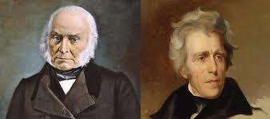
Election of 1824 (Corrupt Bargain)
Clay and Adams
Both Federalists
Both supporters of the American System
1825—decision is made
John Adams elected president by the House of Representatives
Days later—Clay is announced as Adams’s Secretary of State
Jackson and his supporters are outraged
No evidence of a “bargain” being made

Slide 5
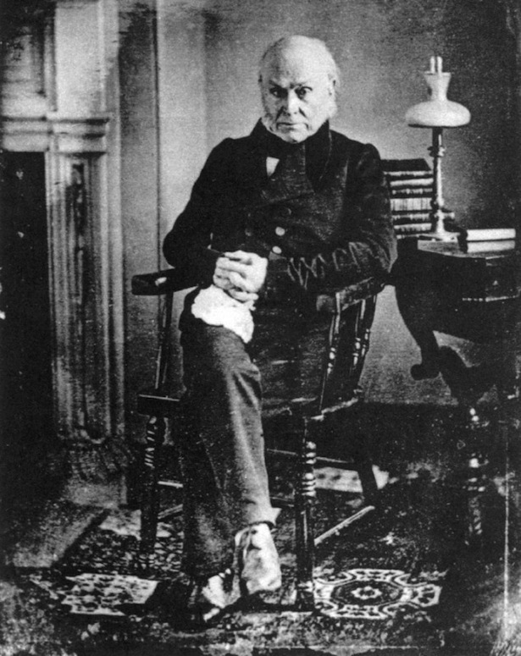
The John Quincy Adams Presidency
Irritable. Sarcastic. Tactless.
More success as Secretary of State than as President
At a disadvantage—the “minority” president
Fewer than 1 in 3 Americans voted for him
Similar to Jefferson in one way
Does not eliminate / fire effective government officials to place his own in
Did not play in to the spoils system
States over nationalism, back to state pride
He urges Congress to build more roads, bridges and canals
He calls for the creation of a national university
Calls for an end to speculation of land
Tried to deal fairly with Native Americans and land issues
States resist anyway!
Costs too much; Government too powerful
Nullification was alive and well

Slide 6
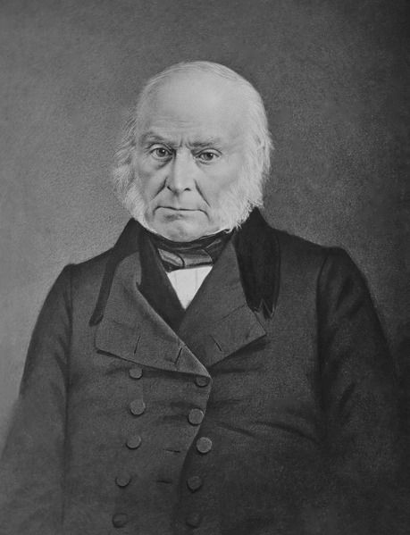
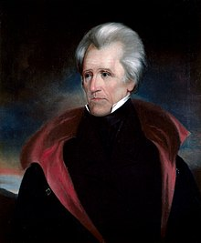
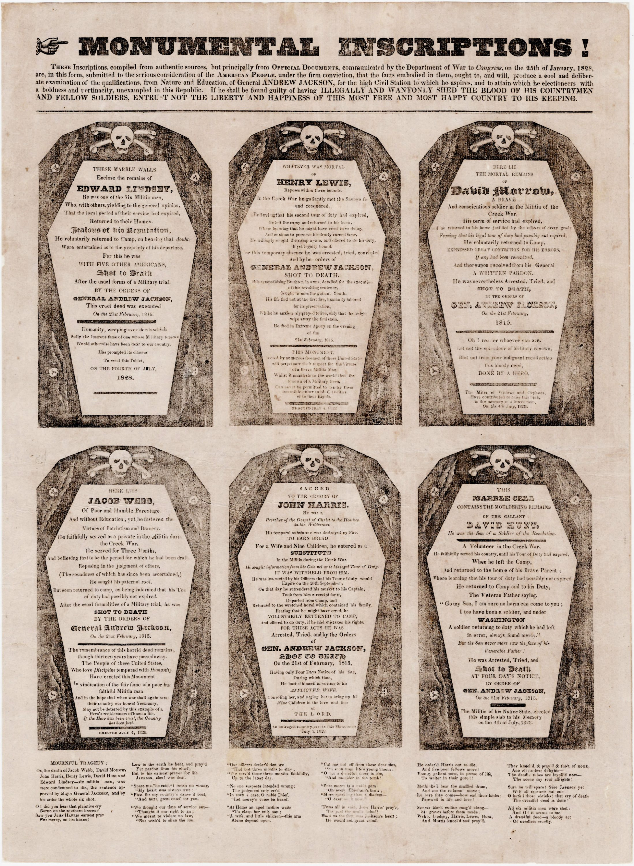
Jackson Reemerges
Mudslinging Campaign
“Bare-knuckle” politics
Jackson’s mother described as a prostitute
Jackson’s wife described as an adulteress
Printed handbills shaped like coffins, representing the men Jackson killed (Indians and duels)
Jackson begins campaigning in 1825 for election
Split in party
National Republicans Democratic Republicans
Symbolized by Oak Symbolized by Hickory
Jackson speaks to the common man—runs with it!
Claim that Adams is corrupt
Claim that Adams is “one of them”
The reality—similar in kind…
Jackson Does It, Too
Adams described as a gambler, overpaid, and was a ‘pimp’ for the Russian Tsar

Slide 7
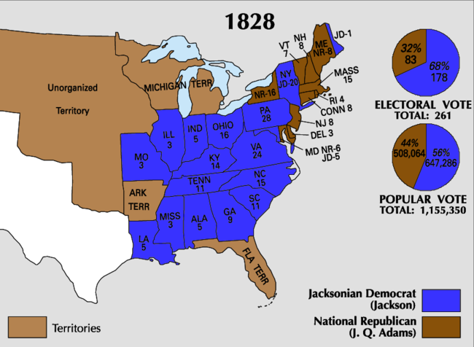
Election of 1828
Voting based on sectional lines
South/West for Jackson
Popular votes enough to push him over the edge in the Electoral count
178-83
Machine politics
Influence of moving west
Jackson is the first “western” president!

Slide 8
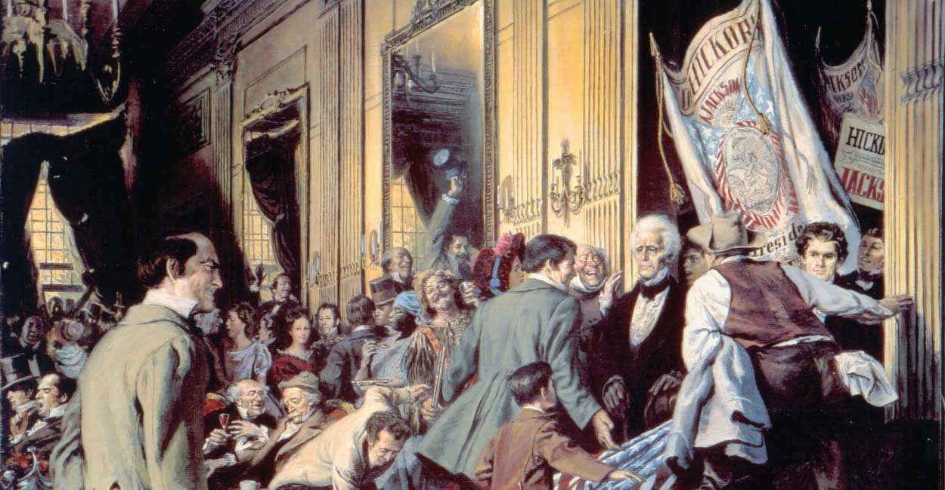
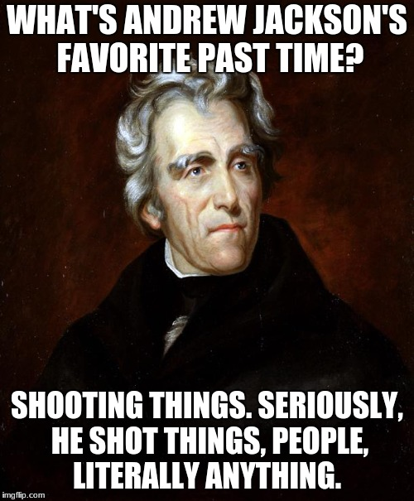
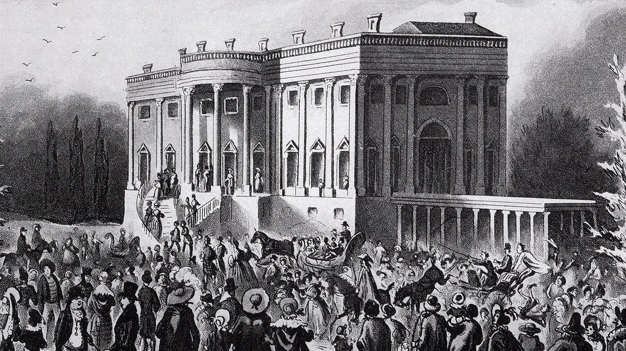
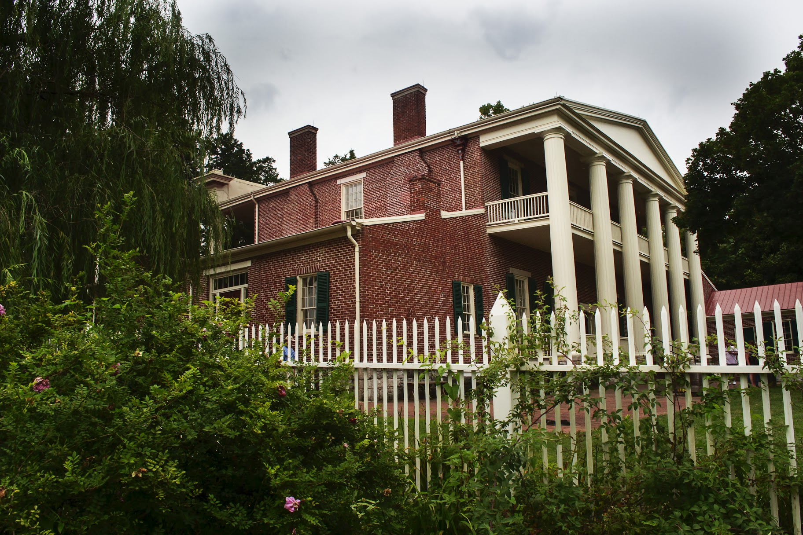
President Jackson’s Personality
Irritable. Emaciated.
Dysentery, malaria, tuberculosis, lead poisoning
Orphaned as a young boy
Brawling over reading
Moves from the Carolinas to Tennessee
Judge, member of Congress
Duels
Passionate
No formal college education
No real “niche”

Slide 9
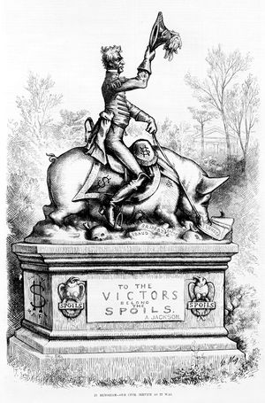
Jackson and the Spoils System
Democrats strike bargains, too
Spoils System
Reward political supporters
Brings in lesser-qualified, “new blood”
“Drain the swamp”
No major overhaul in government since 1800
Jackson appoints high-bidding donors to high positions of authority
Crooks, illiterate, incompetents, etc.
Pick a party and stand by it

Slide 10
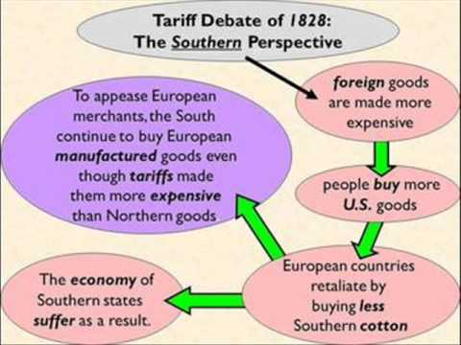
The Tariff of Abominations
Tariffs still in place
Protect American industry
Drive up prices of goods for all Americans
1824—Congress passes a tariff act
Americans call for higher tariffs
Buy more American product—market “booms”
Jackson’s supporters call for another tariff bill—stick it to Adams
Expect it to fail
It passes
Southerners infuriated— “Tariff of Abominations”
Let the New England beware how she imitates the Old
Seen as discriminatory against the South—all regions of US booming EXCEPT south
South sells goods that aren’t taxed, buy goods that are.
Underlying issue—slavery –will government try to get rid of it?

Slide 11
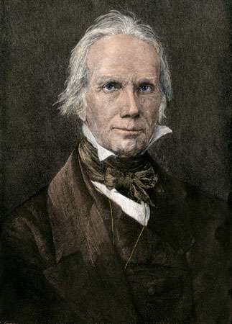
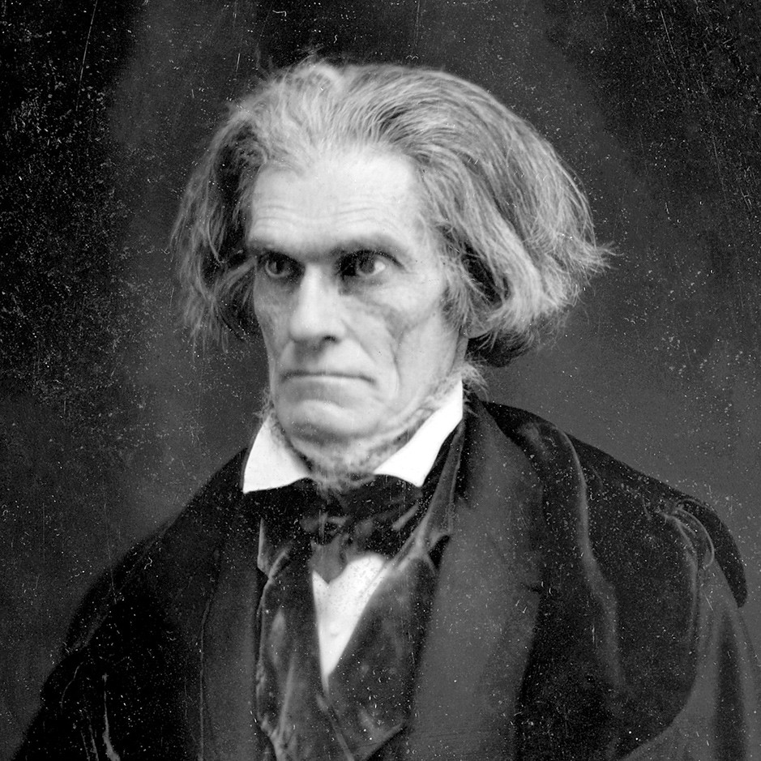
South Carolina Responds
The South Carolina Exposition
Written by John C. Calhoun
Denounced the tariff
Called for states to nullify the law
Nullification Crisis
Citizens in SC try to get a 2/3 vote of the legislature to nullify law
Shot down
New tariff bill in 1832—softens blow some, but not enough
Further calls for nullification, even secession
Jackson Responds
Not a fan of the tariff, but don’t mess with him
Threatens to invade the state, hang nullifiers
Stage Being Set For War
-Fight, surrender, or compromise
-Henry Clay suggests a compromise
Compromise Tariff of 1833
-Reduce Tariff by 10% over period of eight years
Force Bill—POTUS can use military if necessary to collect duties

Slide 12
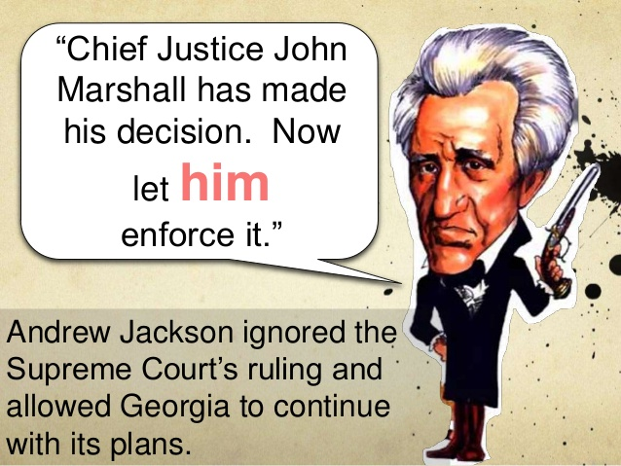
Jackson & the Trail of Tears
Jackson, Jacksonians push for westward expansion
Hundreds of thousands of Natives—no set policy regarding them
Varied by president / congress
Natives harsh towards Americans; Americans don’t always honor treaties
Push among some white citizens to welcome and assimilate Native Americans
Resistance from some tribes, acceptance by others
Cherokees adapt to ‘white’ culture
Council with a three-branch government; alphabet, etc.
George declares Cherokee tribal council illegal
SCOTUS upholds rights of the Natives
Andrew Jackson’s response: John Marshall has made his decision. Now, let him enforce it”
-Jackson wants to “rescue” the “injured race”
-Proposes removal of Cherokees, Creeks, Choctaws, Chickasaws and Seminoles beyond the Mississippi on a ‘voluntary’ basis
-Indian Removal Act passed→ Trail of Tears

Slide 13
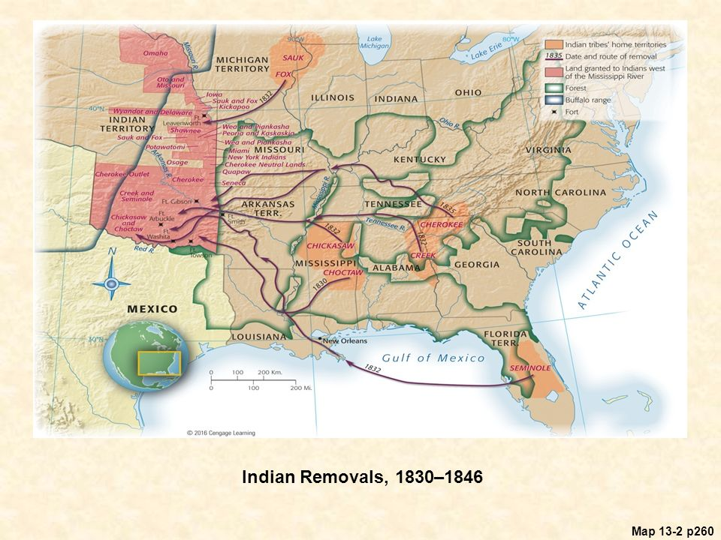
Trail of Tears
Indians set to be “free” from white encroachments
Bureau of Indian Affairs established
Westward push continues
Black Hawk War
Clash between whites & Natives
War in FL with Seminole Indians
Indian revolts crushed; many in present-day Oklahoma

Slide 14
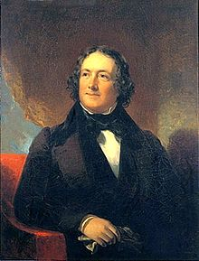
Jackson and the Bank
Nicholas Biddle
Andre Jackson is NOT anti-bank.
He is anti-monopoly and anti-big business
Jackson against the National Bank
Issues gold and silver, but not paper money
Private banks print money—value fluctuates
Power of the nation’s economy in the hands of the bank
A separate “fourth branch”
National Bank was a private institution
Answers to the investors, not the people
Controls the economy!
Against American values of democracy?
Foreclosures in the west, money funneling in the east

Slide 15
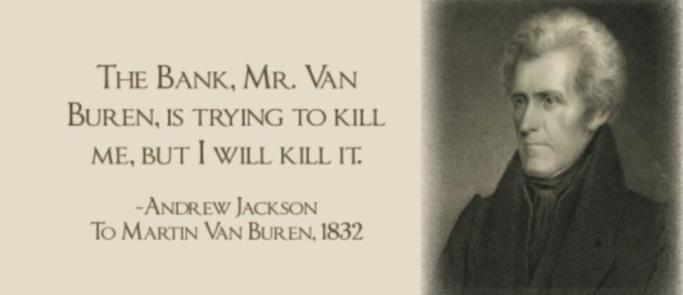
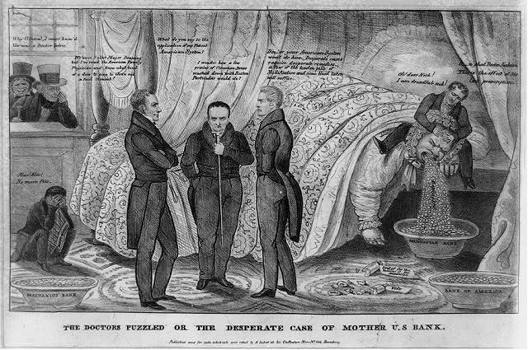
The Bank War
1832—Bank War
Daniel Webster, Henry Clay propose to renew the bank’s charter
Bank not set to expire for four more years
Election year issue
If Jackson signs it—he betrays the common man
If Jackson vetoes it, he loses support from the wealthy in the east
Jackson vetoes the bill anyway—it’s “unconstitutional”
McCulloch v. Maryland declares the bank constitutional PRIOR to this issue
Jackson doesn’t care about SCOTUS ruling
Bank is squashed – and the executive power is asserted
Vetoes previously made on legal grounds; this one on personal grounds.
Repeating Theme in History!

Slide 16
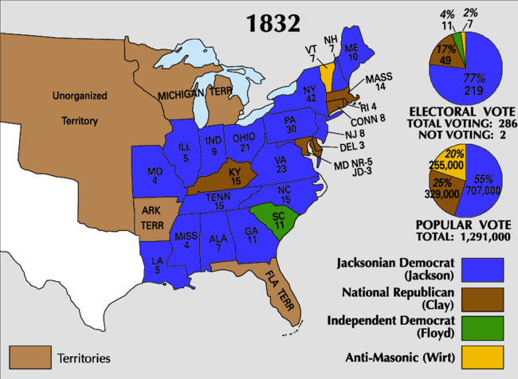
Election of 1832
Andrew Jackson and Henry Clay—main players in the election
Jackson previously favored one-term
First time a third-party played a role
Anti-Masonic Party
Third party importance → TR
Jackson was a Mason
First time you had a national nominating convention
Jackson too popular to be defeated by Clay’s money advantage

Slide 17
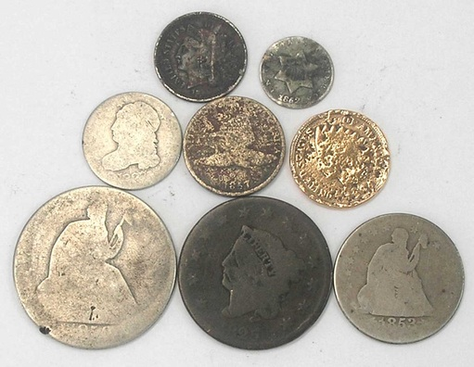
Bank War. Again.
Jackson doesn’t trust the bank to not revive itself, despite the veto
Removes federal deposits from the bank
No more depositing money into the bank
Use existing funds in the vaults to pay day-to-day expenses of the government
Constitutional?
Depends on how you read the document—loosely or strictly!
Jackson’s advisors were against his actions
Jackson shuffles cabinet members around—yes men
Biddle responds by calling in the bank’s loans to save it
Jackson’s actions leads to a series of booms and busts
Federal funds placed in “pet banks”
Pro-Jackson
Many banks exist with nothing more than a suitcase full of money
Unreliable
Jackson authorizes the issue of the SPECIE CIRCULAR—lands had to be bought with “hard” money
Financial Crisis to come—Jackson is out of office by then

Slide 18
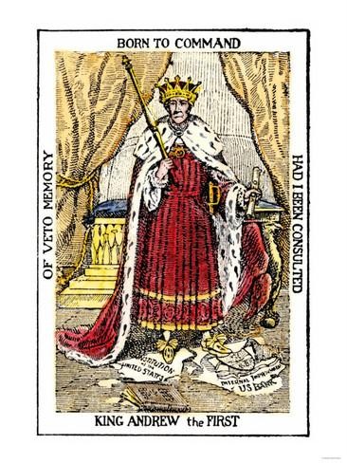
A New Party Emerges
By 1828—new parties emerging
Anti-Jackson refer to him as “King Andrew”
Democrat-Republicans become the “Democrats”
Donkey mascot—Andrew Jackson!
A new party emerges—the Whigs
Revolutionary time; anti-monarchy
Anti-Jackson—censure him
Gain a following
Supporters of the American System, Southerners, Industrialists and merchants, evangelicals, Anti-Masons
Fairly progressive (considered themselves conservative)
Improve within—roads, canals, prisons, schools, etc.
A new party of the people

Slide 19
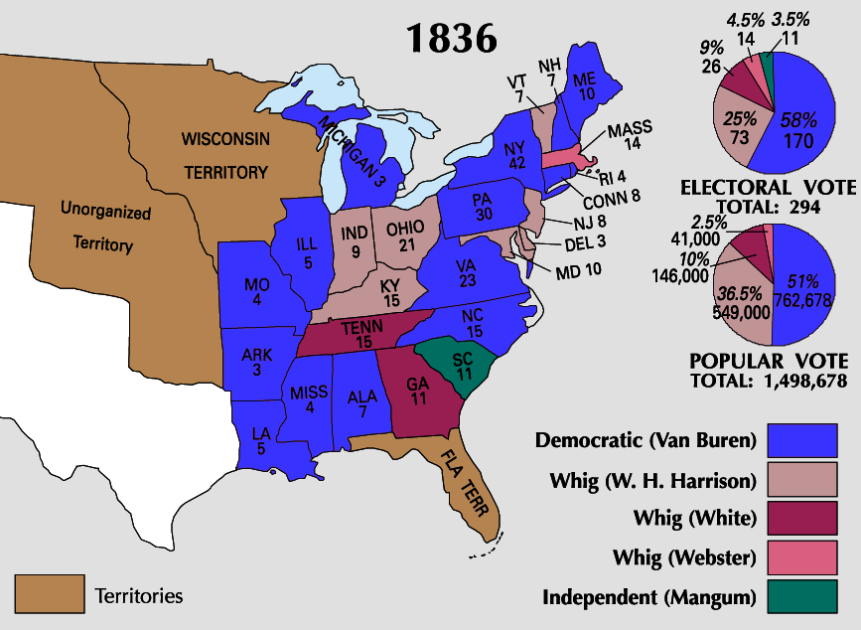
Election of 1836
Jackson pins his “yes man” VEEP for President
Martin Van Buren
Whigs still too unorganized to win
Their strategy—run as many people as possible
Prevent any one candidate from getting a majority of electoral votes
Why? → Twelfth Amendment
_____________________ decides; ___________ have a better chance of winning!
Whigs run three candidates.
Most favored was William Henry Harrison

Slide 20
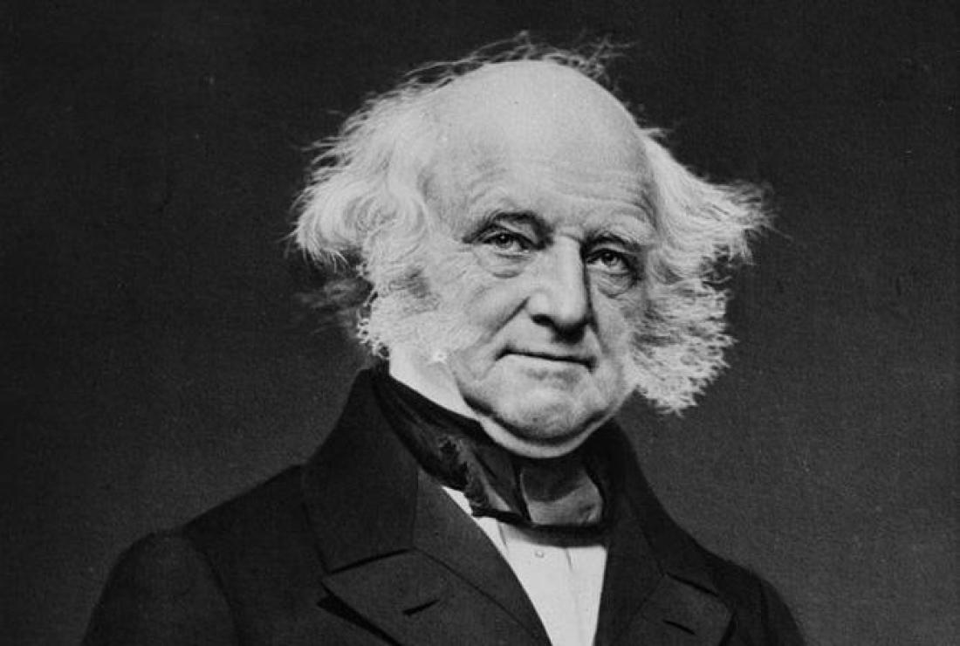
Van Buren as President
Beneficiary of the spoils system
First-class, second-rate man
Brilliant statesman, yet mediocre president
Victim of circumstances beyond his control
“Bastard politician” –machines put him in place
Jackson was eccentric; Van Buren, “meh”
Inherits Jackson’s enemies
Skirmishes with Canada at northern border
Northerners against him because he’s eyeing Texas—more power to the southern slaveholders
Bigger Problem for Van Buren—the economy

Slide 21
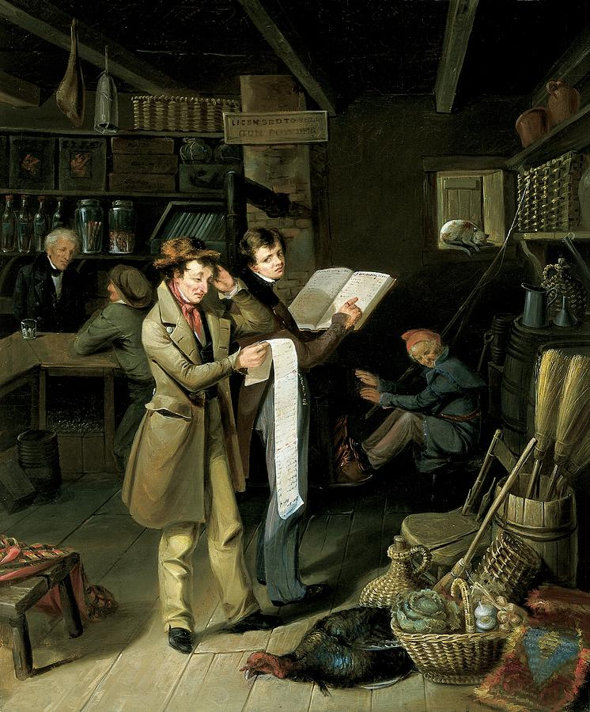
The Panic of 1837
The Long Bill
Cause—speculation; get rich quick scheme
Wildcat (suitcase) banks→ land, roads, canals, etc.
EVERYWHERE!
Bank War by Jackson
Specie Circular
Wheat production shrinks—no grain
Economic problems around the world, too
Banks and business fail
Prices drop
Whigs propose ways to “heal” through tariffs, banks, etc.
Van Buren does nothing
Secures federal deposits in independent banks—leave others high and dry—repealed by Whigs
“Divorce Bill”
Divorce the government from the bank
Van Buren seen as aloof.
Whigs upset—want to revive Bank

Slide 22
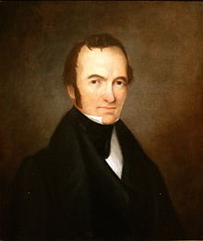
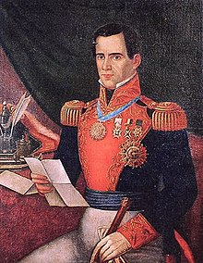
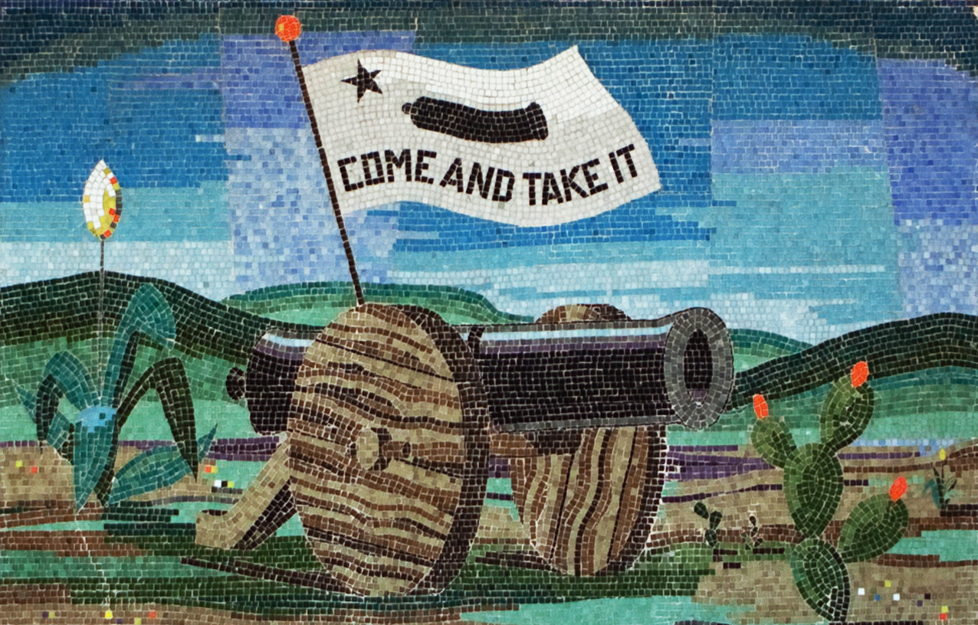
G.T.T.
Stephen Austin, jailed in 1833 by Santa Anna. Mexico starts to crack down on Texas
Americans still want to push west into Texas
Ceded to Spanish when it acquired FL
Mexico gained independence from Spain—populates Texas
Mexico grants land to Stephen Austin 1823
Austin to bring 300 American families; assimilate them into American culture
30,000 by 1835
Austin IGNORES the requests
Those in Texas still consider themselves Americans
Don’t like the presence of Mexican soldiers in “their” territory
Davey Crockett, Jim Bowie, Sam Houston
Issues come up, namely slavery
Mexico emancipates its slaves in 1830; outlawed slavery in Texas
IGNORED
Revolution, Texas style

Slide 23
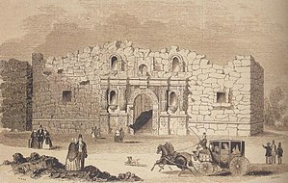
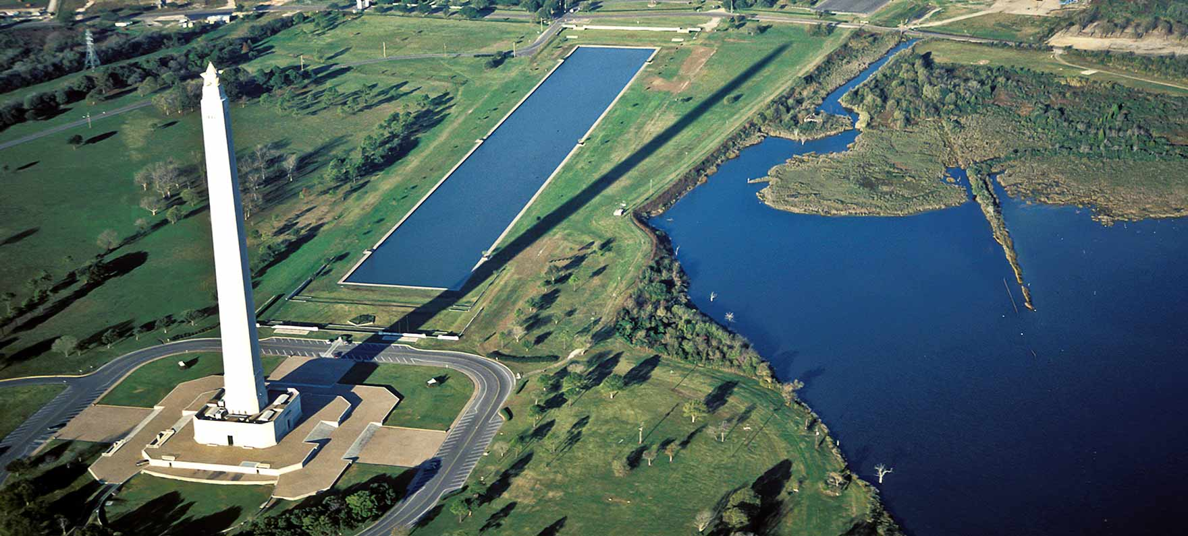
Texas Rebels
Texans declare independence in 1836 (March 2—happy birthday, Texas!)
Led by Sam Houston
Famous battles
Alamo (William Travis— ‘victory or death’)
Goliad
San Jacinto (Emily West, Yellow Rose of Texas)
Mexico’s defeat
Santa Anna agrees to two treaties
Withdraw Mexican troops; acknowledge Rio Grande as border of Texas
Takes back agreement due to “duress”
Mexican Victories
Mexico’s Yorktown

Slide 24
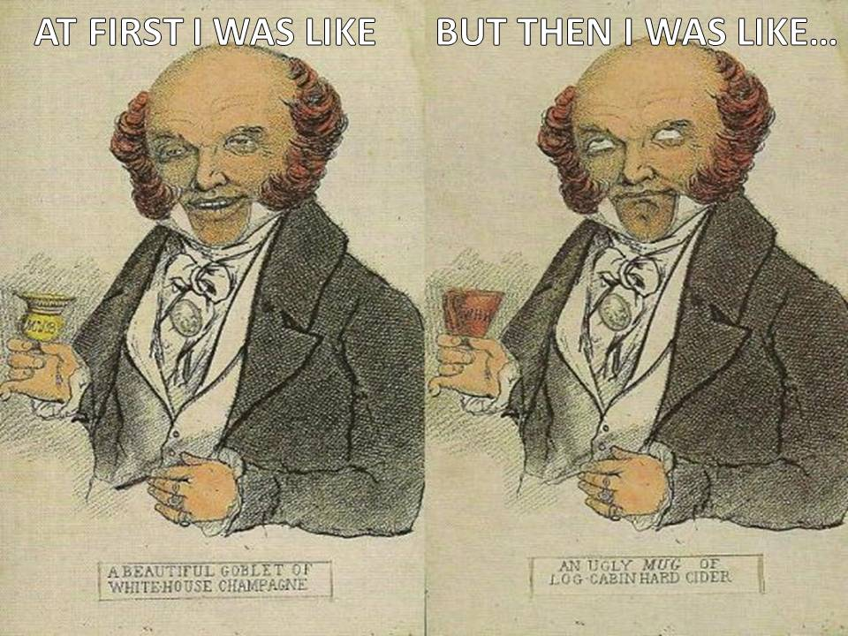
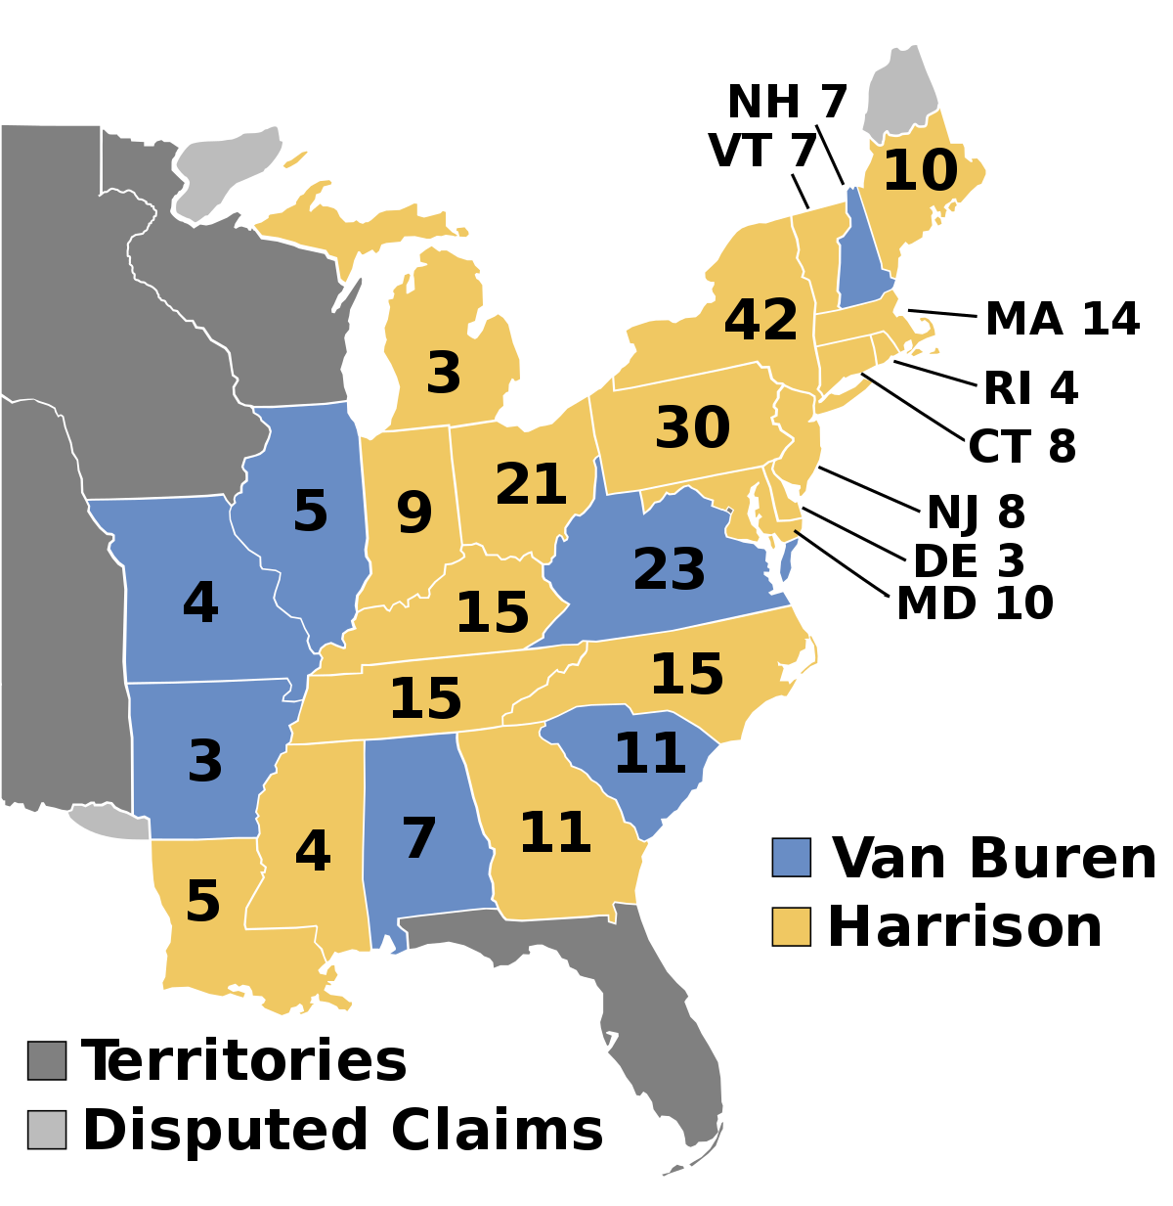
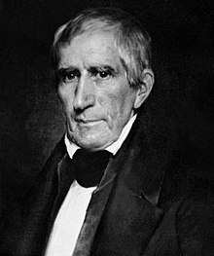
Election of 1840
Van Buren re-nominated by Democrats
Whigs learn from past mistakes—run one candidate
William Henry Harrison
Issue-less, enemy-less
“Tippecanoe and Tyler, too”
Harrison mocked as old, poor, and content with a log cabin and cider
Spoke to the people!
Harrison wins in a landslide (electoral vote)
Popular vote split by <150,000 votes
Issues not really brought up in campaign, but they exist
Economic policy: Whigs want to simulate the economy; Democrats want to end the National Bank policy

Slide 25
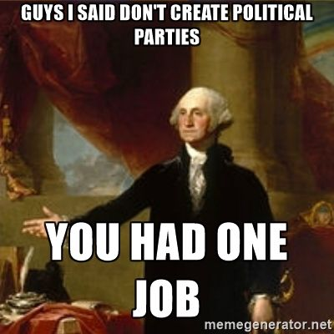
Politicking and the Two-Party System
Election of 1840 matters
Politicians answer to the masses, not just the elite
Establishes the two-party system we see today
Before ‘big’ parties absorbed smaller ones
Political parties viewed as dangerous to country
Ideas too different, now
Both parties (W) and (D)
Claim to represent democratic and republican ideals
(D) liberty and individual rights
(W) harmony and community, more federal control

